Slide 1
How To Process Audio

Slide 2
Process Info
Owner name | Don Burnside
Team | DnD
Resources
Tools | Adobe Audition
Description | Basic audio processing for volume and noise correction
 | AU Member | AU Member | AU Member | AU Member | AU Member | AU Member | AU Member | AU Member | AU Member
Date

Slide 3
Step 1
Right click the audio track in PowerPoint and choose save media as. Save the audio track to a local folder, call it slide XX where xx is the slide number.
Once all audio tracks have been saved, go back and remove them from the powerpoint deck and save it. Remove any page numbers at this time as well.
Open Adobe Audition

Slide 4
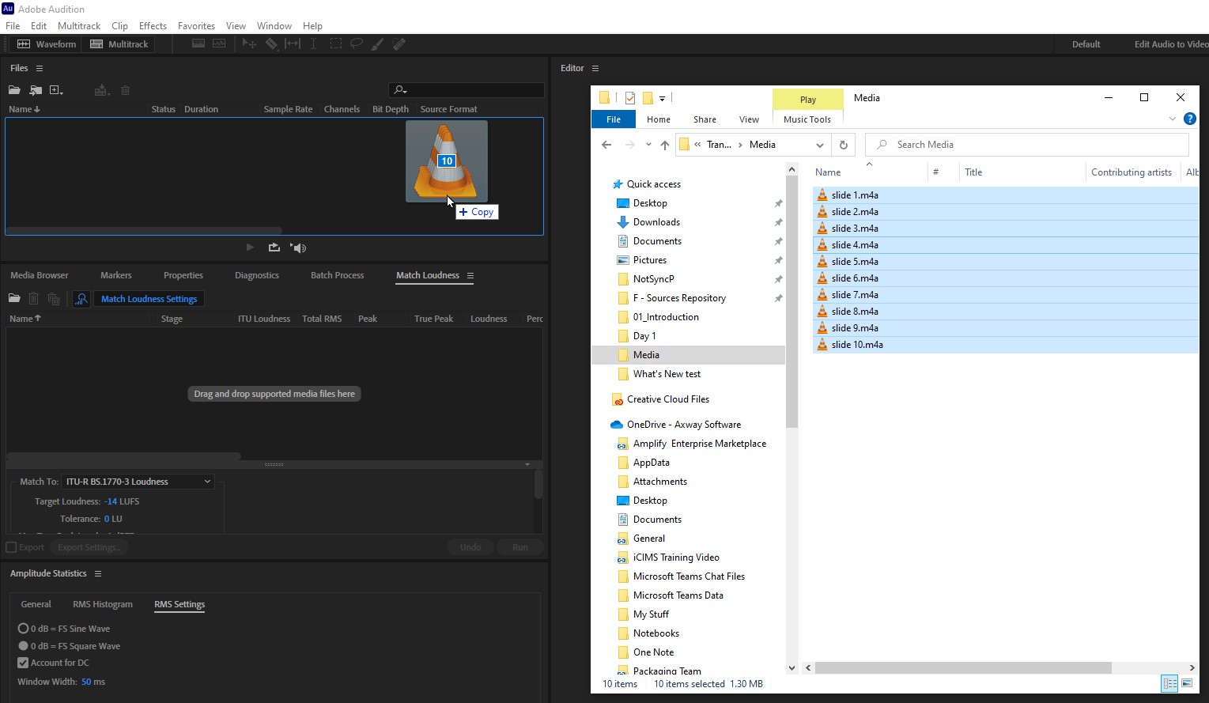
Step 2
Drag audio files into Audition

Slide 5
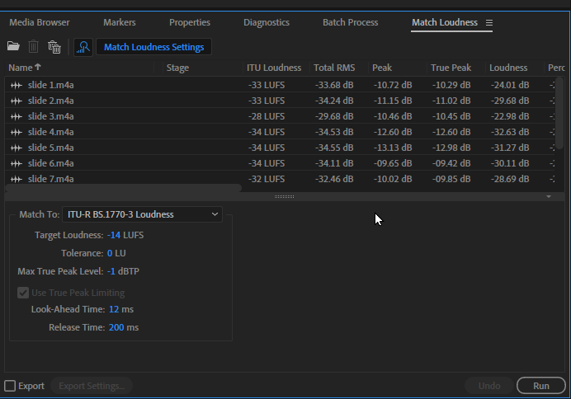
Step 3 – Match Loudness
Click on Match Loudness
Select all audio tracks and drag them into drop area
Set Match To to ITU-R BS.1770-3 Loudness using the drop down
Set Target Loudness to -14 LUFS
Click Run

Slide 6
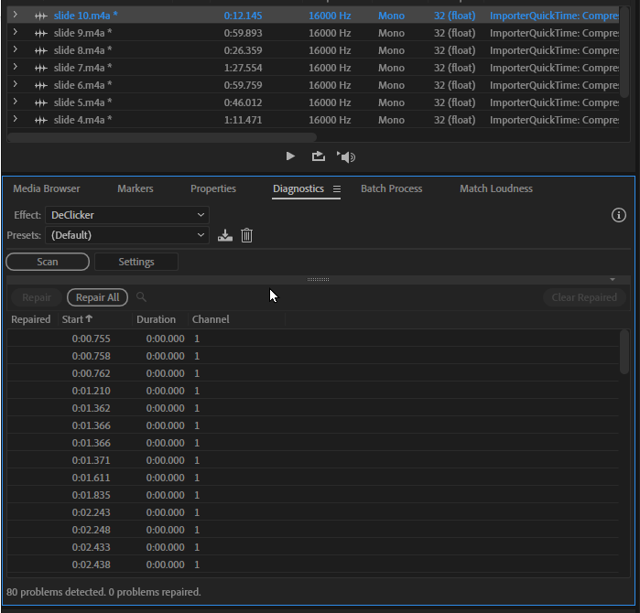
Step 4 - DeClicker
Double click a track to select it
Click Diagnostics tab, select DeClicker from Effect drop down
Click Scan
Click Repair All
Repeat for all tracks.

Slide 7
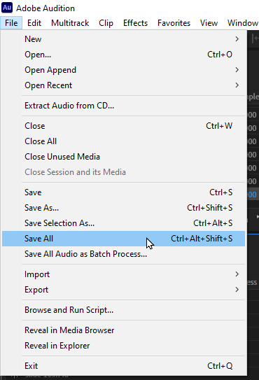
Step 5 – Save All
Click File —> Save All
If prompted, confirm file save location. File type should be .wav by default, if not, change it for best results
Repeat for all tracks
Once saved, drag back into the PowerPoint Deck

Slide 8
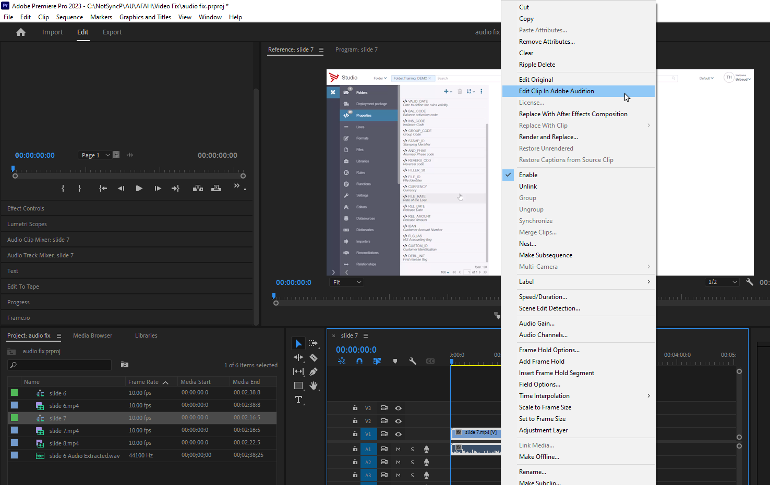
Notes: Video
The preceding steps can be used to process audio from Videos in Adobe Premier
It is best to process audio first before editing video
After processing, save the audio file and it will update in Premier automatically, then continue to edit and expor normally

